Slide 1



Superstore Analysis
Abhishek Sharma

Slide 2
Agenda
Introduction
Primary goals
Database
Implementation and methods used
Summary

Slide 3

Introduction
There is a Superstore in USA which supply products in different parts of USA. They want us to make a dashboard which can help them focus more on right areas of business for increased profit.
3

Slide 4


Primary goals
Improved business by focusing on right segment & category in different regions

Slide 5
“Dataset Used”
A Sample-Superstore dataset is used from Kaggle.com
Dataset has 21 columns telling us about – profit, sales, quantity, city, state, product, segment, category, sub-category, order date, and some other column as well
5

Slide 6
Data pre-processing using python
Step 2
Step 5
Fill the missing values
Export Clean DataFrame into csv file and load in tableau
Step 1
Load csv file into DataFrame
Step 3
Step 4
Get full info of data
Check if any outliers will affect analysis. If so treat them
6

Slide 7




Creating Figma Template
Drag and drop various shapes as per your need in the template and align them
Download the template and use it in creating interactive Dashboard
Login to figma.com
Create a new blank template
Format the shapes and colors inside template in well organized way .
7

Slide 8

Overview of Figma Template
8

Slide 9
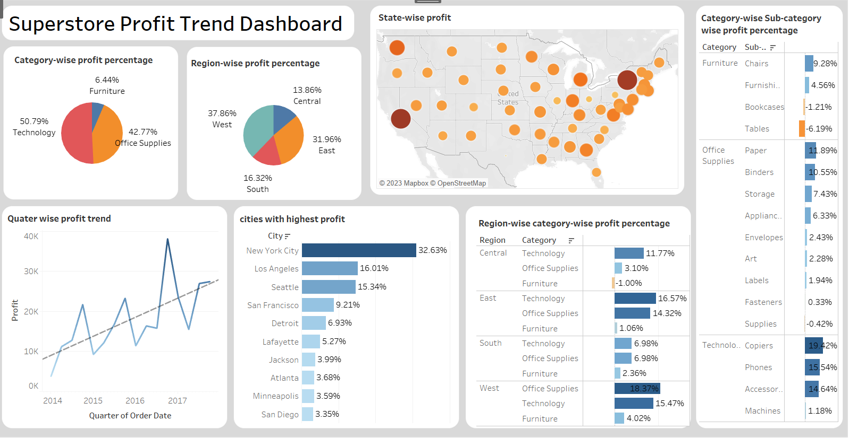
Dashboard

Slide 10

Filters in Dashboard
Filter 1
Filter 5
Source Sheet – Sheet 1
Target sheet – All except Sheet 1
Source Sheet – Sheet 5 Target sheet – All except Sheet 5
Filter 2
Filter 6
Source Sheet – Sheet 2
Target sheet – All except Sheet 2
Source Sheet – Sheet 6 Target sheet – All except Sheet 6
Filter 3
Filter 7
Source Sheet – Sheet 3 Target sheet – All except Sheet 3
Source Sheet – Sheet 7 Target sheet – All except Sheet 7
Filter 4
Source Sheet – Sheet 4 Target sheet – All except Sheet 4
10

Slide 11

Areas of focus
Positive points
Negative points
Technology and office supplies category have majority in terms of profit.
Profit for stores in increasing year by year
West and east region have more sales as compared to central and south
Furniture category in all region is showing negative profit or very less profit.
Inside furniture Bookcases and tables are showing negative profit.
11

Slide 12

Summary
Now the Superstore can use this dashboard to look in details in all terminology. They can look out for small details using filters and take important decision to increase their profit. They can take important decision like –
Which segment need more focus, or which segment should be discontinued.
Which region is showing more profit consistently.
Which sub-category is most profitable and which is least.
States with highest profit
In which quarter profits are more
What is the trend for each category or sub-category or region or state.
12

Slide 13




Thank you
Abhishek Sharma
as826385@gmail.com

